Slide 1
Hadoop WordCount Example
CSC 4760 / 6760 Big Data Programming
Spring 2020
Chapter 1 Design Patterns and MapReduce. Book: MapReduce Design Patterns, Donald Miner & Adam Shook, 2012.

Slide 2
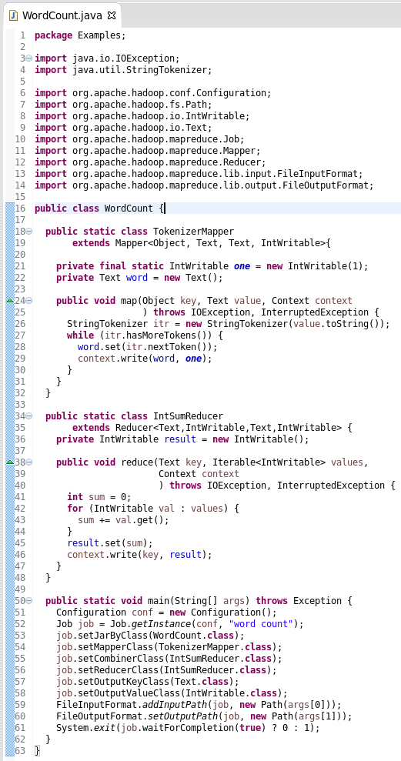
MapReduce Code: WordCount
https://hadoop.apache.org/docs/stable/hadoop-mapreduce-client/hadoop-mapreduce-client-core/MapReduceTutorial.html

Slide 3
Generic Type
public class Box {
private Object object;
public void set(Object object) { this.object = object; }
public Object get() { return object; }
}
A generic type is a generic class or interface that is parameterized over types.
/* Generic version of the Box class.
* @param <T> the type of the value being boxed */
public class Box<T> {
// T stands for "Type"
private T t;
public void set(T t) { this.t = t; }
public T get() { return t; }
}
Java Tutorials: Generic Types
https://docs.oracle.com/javase/tutorial/java/generics/types.html

Slide 4
public class Mapper<KEYIN, VALUEIN, KEYOUT, VALUEOUT> {
/* Called once for each key/value pair in the input split. Most applications
* should override this, but the default is the identity function.*/
@SuppressWarnings("unchecked")
protected void map(KEYIN key, VALUEIN value,
Context context) throws IOException, InterruptedException {
context.write((KEYOUT) key, (VALUEOUT) value);
}
}
src/main/java/org/apache/hadoop/mapreduce/mapper.java
public class Reducer<KEYIN,VALUEIN,KEYOUT,VALUEOUT> {
/* This method is called once for each key. Most applications will define
* their reduce class by overriding this method. The default implementation
* is an identity function. */
@SuppressWarnings("unchecked")
protected void reduce(KEYIN key, Iterable<VALUEIN> values, Context context
) throws IOException, InterruptedException {
for(VALUEIN value: values) {
context.write((KEYOUT) key, (VALUEOUT) value);
}
}
}
src/main/java/org/apache/hadoop/mapreduce/reducer.java

Slide 5
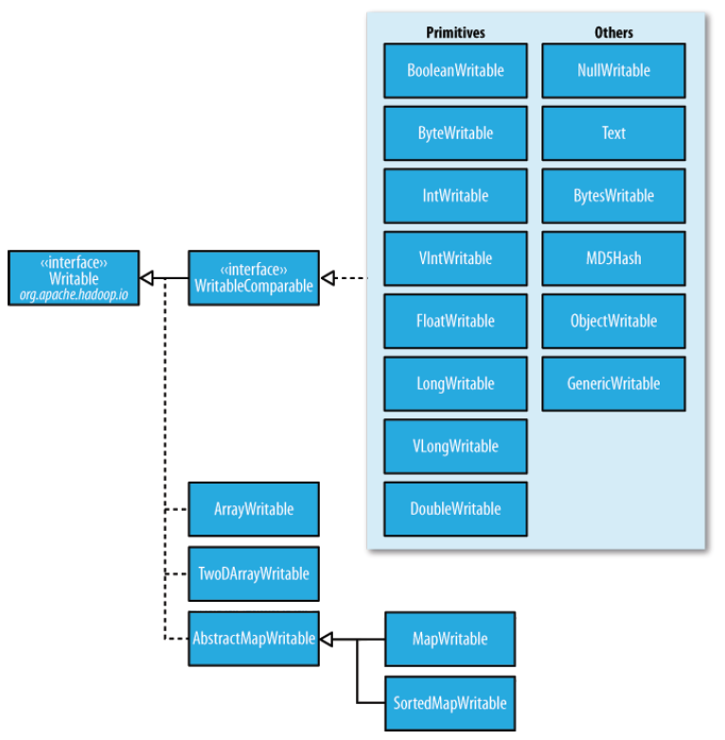
Writable class hierarchy

Slide 6
MapReduce Code
main() method
Job object - Collects up all the specs for the job
Input and output paths (passed via the command line)
Input and output file formats
Key/Value types
Mapper and Reducer classes
Configuration object - forwarded to map(), reduce()
Job level parameters communicated via this object

Slide 7
MapReduce Code
MapClass
Extends Mapper, declaring the input and output pair types for the map() method
map() method
Arguments: input pair, and the Context
Output done via the context object
The output key/value pairs do not need to be of the same type of the input key/value pairs.

Slide 8
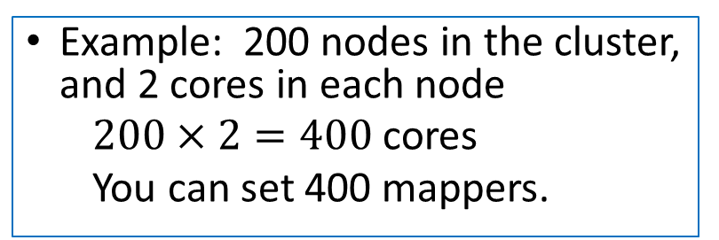
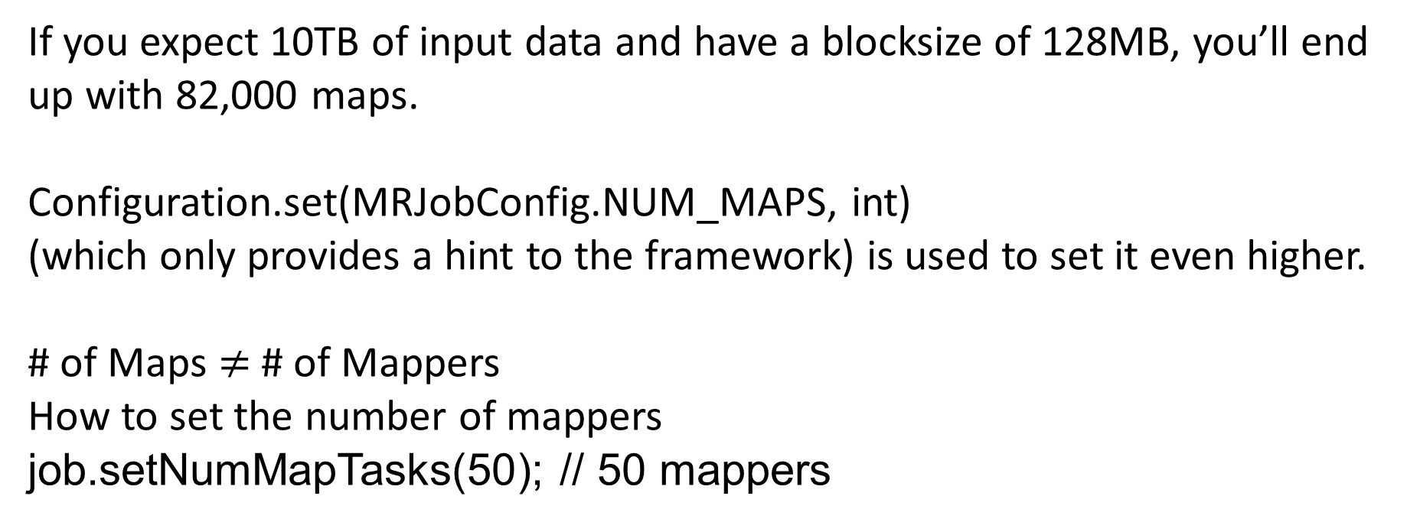
Number of Mappers
If you expect 10TB of input data and have a blocksize of 128MB, you’ll end up with 82,000 maps.
Configuration.set(MRJobConfig.NUM_MAPS, int)
(which only provides a hint to the framework) is used to set it even higher.
# of Maps $≠$ # of Mappers
How to set the number of mappers
job.setNumMapTasks(50); // 50 mappers
Example: 200 nodes in the cluster, and 2 cores in each node
$200×2=400$ cores
You can set 400 mappers.

Slide 9
MapReduce Code
ReduceClass
Extends Reducer, declaring the input and output pair types for the reduce() method
reduce() method
Arguments: input pair, and the Context
Output done via the context object
The output of the reduce task is typically written to the FileSystem via Context.write(WritableComparable, Writable).

Slide 10
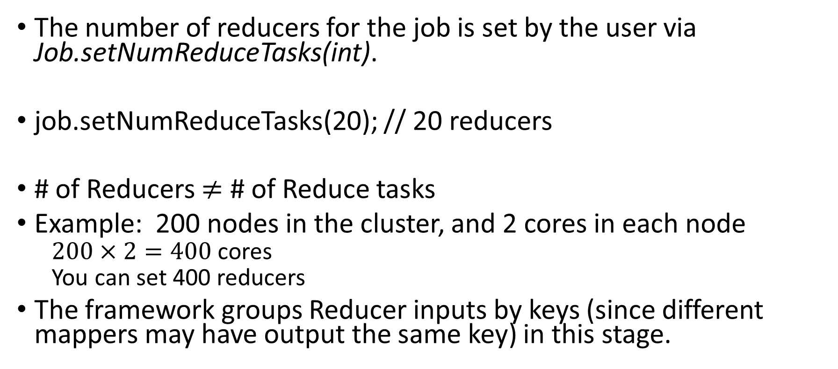
Number of Reducers
The number of reducers for the job is set by the user via Job.setNumReduceTasks(int).
job.setNumReduceTasks(20); // 20 reducers
# of Reducers $≠$ # of Reduce tasks
Example: 200 nodes in the cluster, and 2 cores in each node
$200×2=400$ cores
You can set 400 reducers
The framework groups Reducer inputs by keys (since different mappers may have output the same key) in this stage.

Slide 11
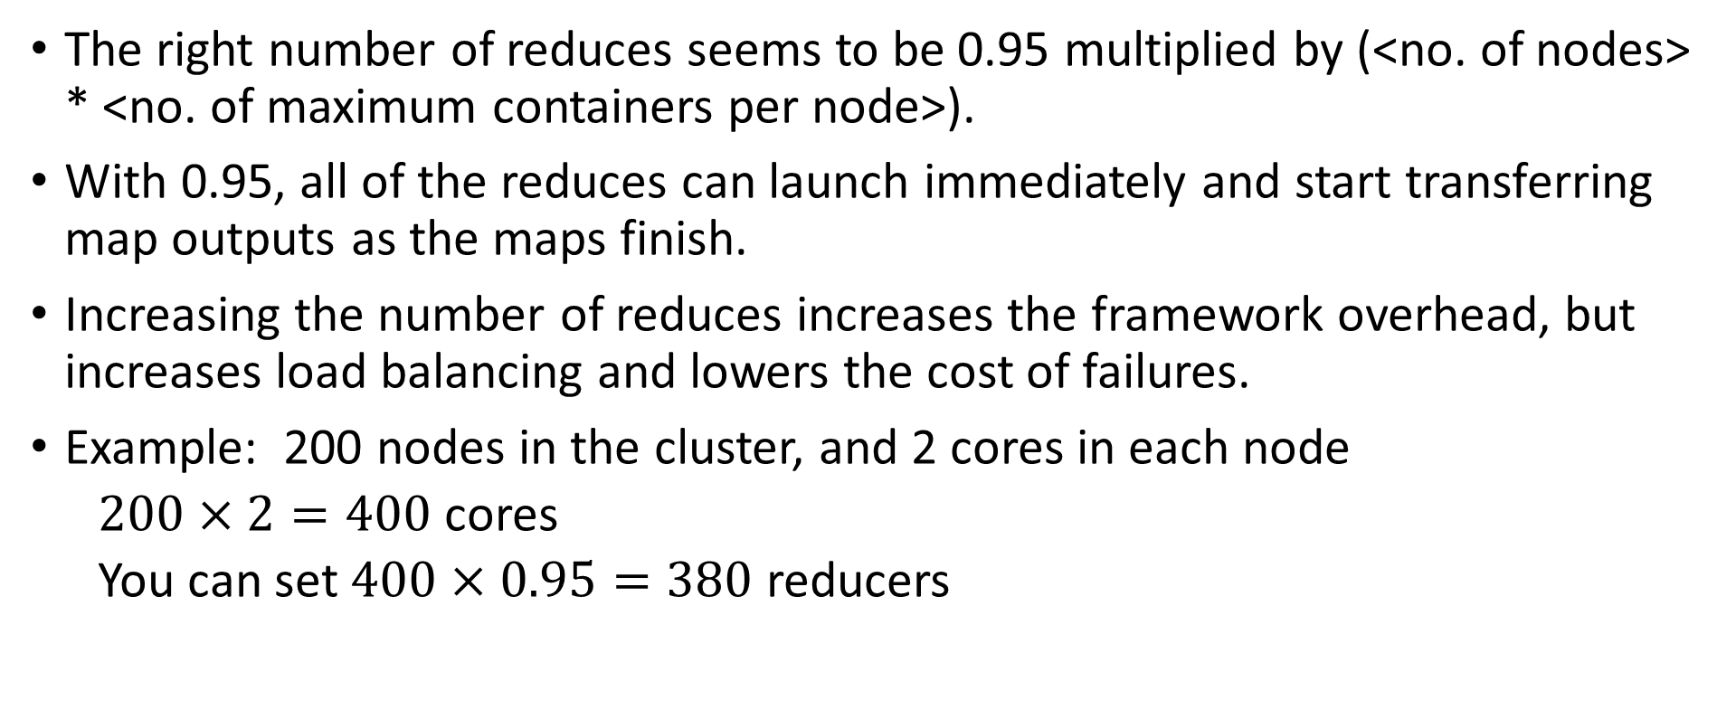
Number of Reducers
The right number of reduces seems to be 0.95 multiplied by (<no. of nodes> * <no. of maximum containers per node>).
With 0.95, all of the reduces can launch immediately and start transferring map outputs as the maps finish.
Increasing the number of reduces increases the framework overhead, but increases load balancing and lowers the cost of failures.
Example: 200 nodes in the cluster, and 2 cores in each node
$200×2=400$ cores
You can set $400×0.95=380$ reducers

Slide 12
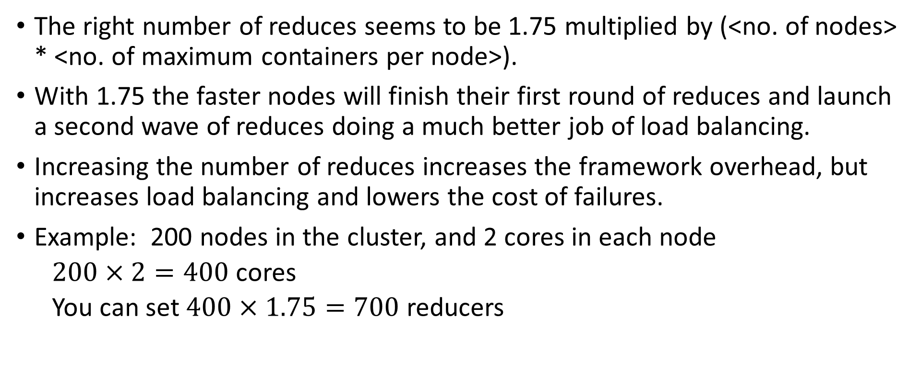
Number of Reducers
The right number of reduces seems to be 1.75 multiplied by (<no. of nodes> * <no. of maximum containers per node>).
With 1.75 the faster nodes will finish their first round of reduces and launch a second wave of reduces doing a much better job of load balancing.
Increasing the number of reduces increases the framework overhead, but increases load balancing and lowers the cost of failures.
Example: 200 nodes in the cluster, and 2 cores in each node
$200×2=400$ cores
You can set $400×1.75=700$ reducers

Slide 13
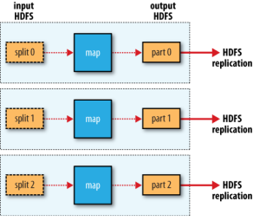
Zero Number of Reducers
It is legal to set the number of reduce-tasks to zero if no reduction is desired.
In this case the outputs of the map-tasks go directly to the FileSystem, into the output path set by FileOutputFormat.setOutputPath(Job, Path). The framework does not sort the map-outputs before writing them out to the FileSystem.

Slide 14
MapReduce Code
map() and reduce() input pair and output pair types
Derived from Writable
readFields(DataInput in)
write(DataOutput out)
Text, IntWritable, LongWritable all implement Writable
As do many other types, some of which we will use
Possible to design your own class that implements Writable

Slide 15
MapReduce Code
Combiner – combines multiple outputs from a Mapper before shuffle
Input and output pair types must be the same.
Why?
When can a combiner be used?
Map output can be processed (“combined”) even through we do not see all values associated with the key
Combiner output can be interpreted by reducer
Word count, and many other counting applications can use a combiner.

Slide 16
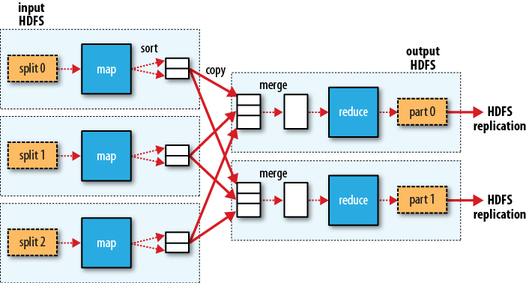
combiner
MapReduce data flow in Hadoop

Slide 17
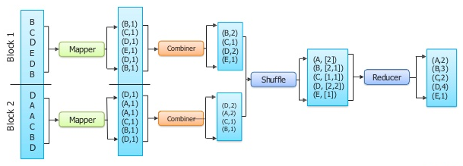
Combiner Optimization
MapReduce: simplified data processing on large clusters.
Jeffrey Dean and Sanjay Ghemawat,
OSDI, 2004.

Slide 18
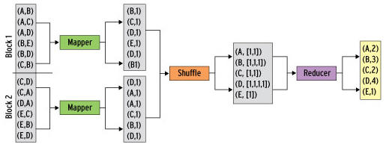
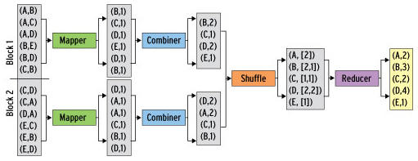
Combiner Optimization

Slide 19
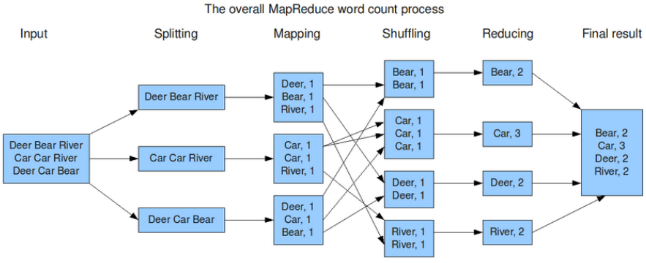
Combiner Optimization
Car, 2
Car, 2
MapReduce: simplified data processing on large clusters.
Jeffrey Dean and Sanjay Ghemawat,
OSDI, 2004.

Slide 20
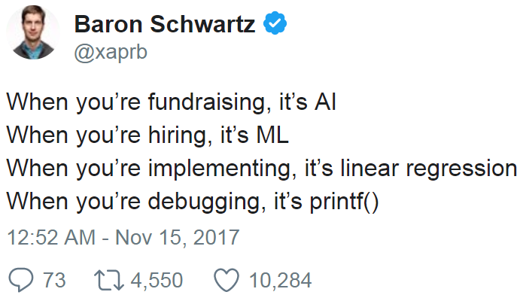
Simple Debugging
System.out.println(“Debug”);
Counters
controller
Syslog
Custom counters
context.getCounter(group, counter).increment(1L);
group and counter are strings

Slide 21
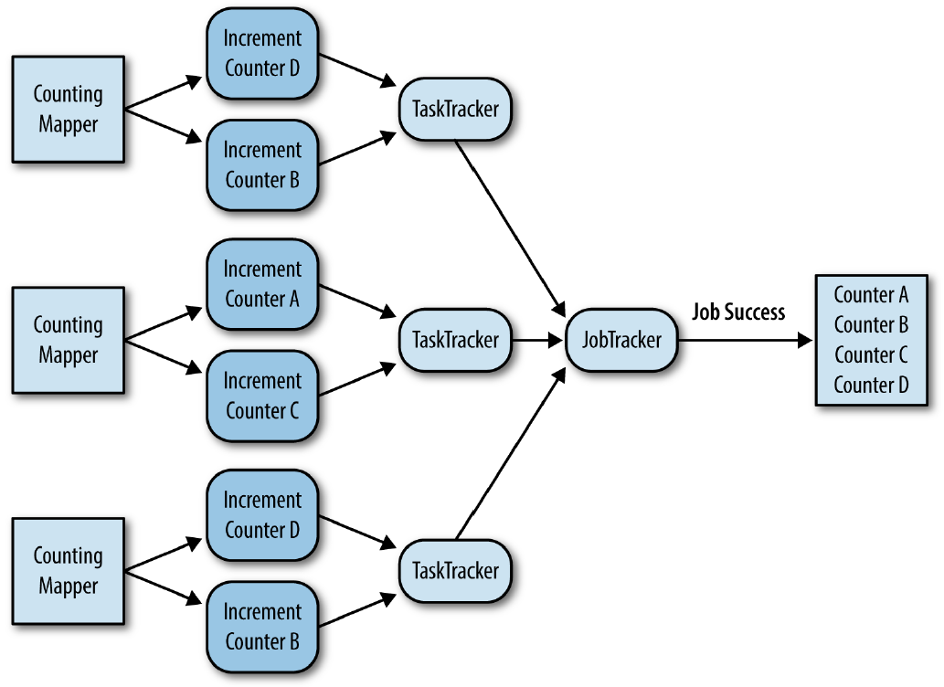
Hadoop Counters
Figure 2-6, MapReduce Design Patterns, Page 39

Slide 22
Hadoop Counters
Default number of counters: 120
mapreduce.job.counters.limit
https://hadoop.apache.org/docs/r3.0.0/hadoop-mapreduce-client/hadoop-mapreduce-client-core/mapred-default.xml
Override it by changing “mapred-site.xml”
<configuration>
...
<property>
<name>mapreduce.job.counters.limit</name>
<value>500</value>
</property>
...
</configuration>
API Docs:
https://hadoop.apache.org/docs/r3.0.0/api/org/apache/hadoop/mapred/Counters.html

Slide 23
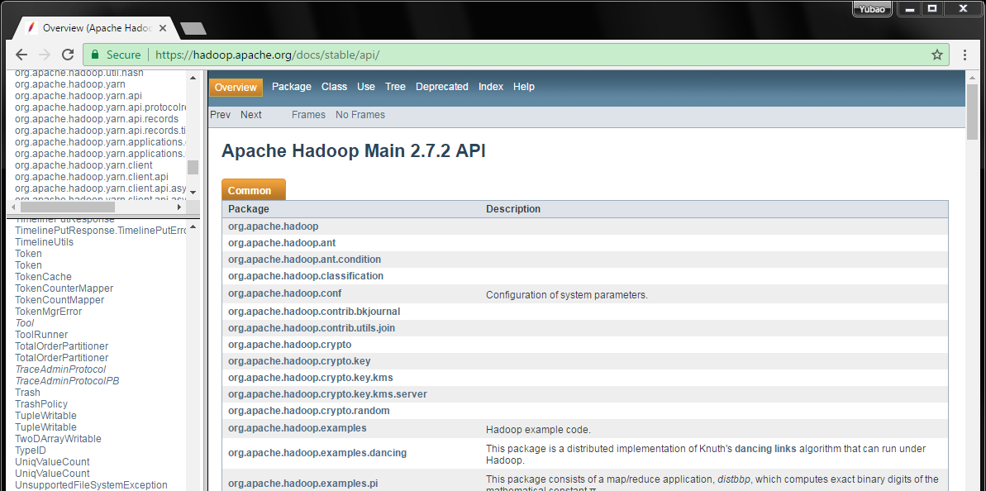
Apache Hadoop Main 2.7.2 API
https://hadoop.apache.org/docs/stable/api/

